Slide 1

Holy War
Joshua 6:1-21 21

Slide 2
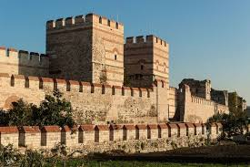
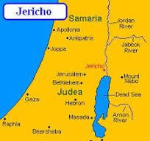
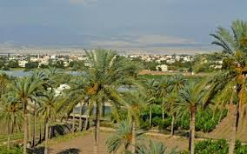
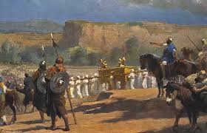
Jericho

Slide 3
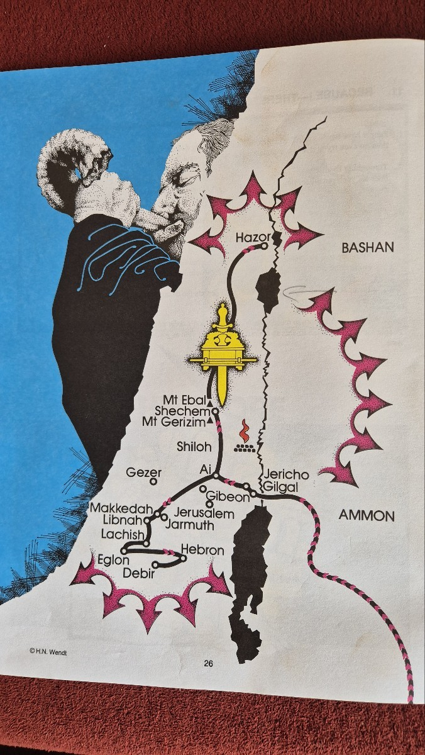
Joshua 6:1, “Jericho was tightly shut because of the children of Israel; no one went out or came in’
Numbers 13:28, “But the people who live in the land are strong, and the city is fortified and very large. Moreover, we saw the descendants of Anak there’
Deuteronomy 1:28, “Where shall we go? Our brothers discouraged us, saying, ‘The people are taller and taller than we, and the city is large, and its walls reach up to the heavens.’”

Slide 4
Holy War
1) God’s Promise
Joshua 6:2, “Then the Lord said to Joshua, ‘See, I have given Jericho into your hand, along with its king and its warriors.’”
Joshua 1:1-8. “I have already given it to you.”

Slide 5
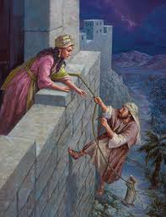
2) Faith
. Who is Rahab?
. Woman
. Prostitute
. Canaanite
Joshua 2:11, “For the Lord your God is God in heaven above and on the earth beneath.”
Joshua 2:10, “For we have heard how the Lord dried up the water of the Red Sea before you when you came out of Egypt, and what you did to the two kings of the Amorites who were on the other side of the Jordan, to Sihon and Og, whom you utterly destroyed.”
Joshua 2:11, “And when we heard it, our hearts melted.”
Matthew 1:5-6, “Salmon begot Boaz by Rahab, and Boaz begot Obed by Ruth, and Obed begot Jesse, and Jesse begot David the king.”

Slide 6
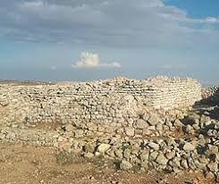
3) Holiness
Joshua 7:4-5. “About three thousand men went up and fled before the men of Ai. And the men of Ai struck them down, about thirty-six men. They pursued them from outside the gate to Shebarim and struck them on the descent. So the hearts of the people melted and became like water’
Joshua 6:27. “The Lord was with Joshua, and his fame spread throughout all the land.”
Joshua 7:3, “They returned to Joshua and said to him, ‘Don’t let all the people go up; let only two or three thousand men go up and attack Ai. They are few in number; don’t let all the people go there and make it hard for them.”
Joshua 7:1? “The children of Israel sinned in the accursed thing, because Achan the son of Carmi, the son of Zabdi, the son of Zerah, of the tribe of Judah, took the accursed thing. And the LORD was angry with the children of Israel.”
Joshua 7:21-22, “When I saw among the spoils a beautiful mantle from Shinar, and two hundred shekels of silver, and a bar of gold weighing fifty shekels, I coveted them and took them. And now, behold, they are hidden in the earth in the midst of my tent, and the silver is under it.” Joshua 6:18-19. “You shall not touch the devoted things, lest you take any of the devoted things and make them an offering to the camp of Israel, and you be afflicted. All the silver and gold, all the articles of bronze and iron, are holy to the Lord; they shall be brought into the treasury of the Lord.”

Slide 7
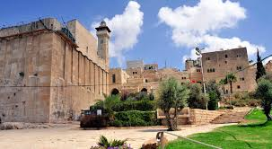
4) Courage
Who is Caleb?
. Too old (85 years)
. Edomite
. Loser in leadership competition
Joshua 14:12, “Joshua, give me the hill country. You heard that day that the Anakim were there and that the cities were fortified. If the LORD will be with me, I will drive them out, just as the LORD said.”
Joshua 14:6, “Then the children of Judah came to Joshua at Gilgal, and Caleb the son of Jephunneh the Kenizzite said to Joshua, ‘Here is the Kenizzite.’”
Joshua 14:8, “Because I have been faithful to the Lord my God.”

Slide 8
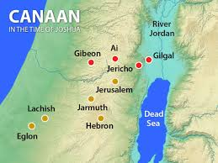
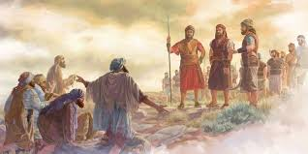
5) Spiritual Discernment
Joshua 9:4-5, “They made a conspiracy and set up a messenger, carrying worn-out bags and wineskins worn out and torn and mended on their donkeys. They had worn-out sandals on their feet, and they were wearing old clothes. They prepared bread that was dry and moldy.”
Joshua 9:14-15, “So they took their provisions and did not ask the Lord what to do. Joshua made a covenant with them and let them live. The leaders of the congregation swore an oath.”
Reasons why Joshua was deceived
. Their appearances
. Religious language
. Gifts

Slide 9

6) Strategy
Adaptation
. Adolf von Harnack (1851-1930), ‘Mission and the Expansion of Christianity in the Early Third Century’.
. Simplicity
. Versality
Jericho Strategy | Ai Strategy
Public, daytime, large-scale military operations with everyone involved. Standing fight | Private, nighttime. Ambush operations with a small number of elite troops hiding. Lying down fight

Slide 10
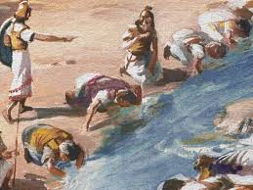
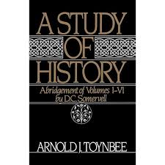
(2) Creative Minority
. Gideon’s 300 Warriors
Jdg 7:5-6 So he brought the people down to the water. And the LORD said to Gideon, "Every one who laps the water with his tongue, as a dog laps, you shall set by himself. Likewise, every one who kneels down to drink."
. Creative Minority
. Jesus Discipleship
Come and See (Selection) | Come and Follow (Training) | Come and Go (Sending)

Slide 11
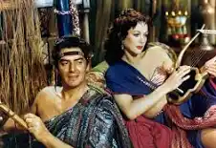
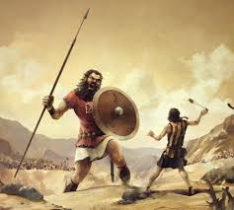
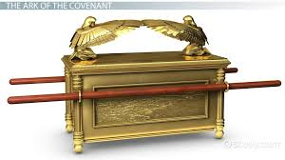
(3) 3L Strategy
WEC (Worldwide Evangelization for Christ)
. To the Last
. To the Latest
. To the Least
Joshua 11:21-22. “Then Joshua came and cut off the Anakim from the hill country, from Hebron, from Debir, from Anab, from all the hill country of Judah, and from all the hill country of Israel. He utterly destroyed their cities. None of the Anakim were left in the land of the children of Israel; only Gaza, Gath, and Ashdod remained.”
Gaza | Gath | Ashdoth
Dellilah | Goliath | Ark
Sex | Power | Idol

Slide 12
Get up! (Rise up again!)
You Raise Me Up
When I am down and, oh, my soul, so weary
When troubles come and my heart burdened be
Then I am still and wait here in the silence
Until You come and sit awhile with me
You raise me up so I can stand on mountains
You raise me up to walk on stormy seas
I am strong when I am on Your shoulders
You raise me up to more than I can be
You raise me up so I can stand on mountains
You raise me up to walk on stormy seas
I am strong when I am on Your shoulders
You raise me up to more than I can be
You raise me up (up) so I can stand on mountains
(stand on mountains)
You raise me up to walk on stormy seas (stormy seas)
I am strong (I am strong) when I am on Your shoulders (ooh)
You raise me up to more than I can be
You raise me up (up) so I can stand on mountains
(stand on mountains)
Joshua 7:10, “The Lord said to Joshua, ‘Get up! Why have you fallen down like this?’”.
Judges 4:14, “Get up! The Lord has given Sisera into your hand.”
Acts 3:6, “Silver and gold I do not have, but in the name of Jesus Christ of Nazareth, rise up and walk.”

